Slide 1
Binary Search
2nd Ed: Pgs 134 – 139
3rd Ed: Pgs 151-156
BSc in Software Development
Data Structures & Algorithms
Notes:
BSc in Software Development - Year 2
Computer Science 1
Binary Searching

Slide 2
Binary Search (Internal Search):
Introduction
  Information retrieval is one of the most important applications of computers
  Telephone Number Account Number => Transactions Employee Name => details
  Keys
  Searching is time consuming
  Measure by counting the number of times one key is compared with another key.
  External and Internal Searching
BSc in Software Development
Data Structures & Algorithms

Slide 3
Binary Search:
How would you go about finding a name in a telephone book?
Suppose we wanted to find the name “Donnelly”. We would open the book somewhere around the middle, maybe at the names starting with “M”.
The name we are looking for comes before the names starting with “M”, so we would forget about the second half of the book (because it contains names that come after ones starting with “M”).
So with one comparison, half of the book is discarded and we continue on searching the first half for the name “Donnelly”.
BSc in Software Development
Data Structures & Algorithms

Slide 4
We now do the same again.
We would open the book somewhere around the middle of the first half, maybe at the names starting with “G”.
The name we are looking for comes before the names starting with “G”, so we would forget about the second half of this half (because it contains names that come after the names starting with “G”).
So now again with one comparison, half of what we are searching is discarded and we continue on searching the first quarter for the name “Donnelly”.
We continue in the same way until we find “Donnelly” in the book or determine that it is not there.
BSc in Software Development
Data Structures & Algorithms

Slide 5

A Binary Search of a phone book
A - Z
A - M
A - G
A - C
D - G
BSc in Software Development
Data Structures & Algorithms

Slide 6
A – Z
A – M M – Z
A – G G – M M – S S - Z
A – C D – G
BSc in Software Development
Data Structures & Algorithms

Slide 7
The List to be Searched
The list is declared as follows
struct ListType
{
int length;
int info[MAX_ITEMS];
}
ListType list;
So what does list look like in memory?
BSc in Software Development
Data Structures & Algorithms

Slide 8
list looks as follows:
list
length info
[0] [1] [2] … … [MAX_ITEMS–1]
3 9 5 12
list.length = 3;
list.info[0] = 9;
list.info[1] = 5;
list.info[2] = 12;
BSc in Software Development
Data Structures & Algorithms

Slide 9
Binary Search Algorithm:
Start with the entire sorted array. i.e. the search area goes from index 0 to index list.length – 1 within our array list.info.
Each time around the loop
  divide the current search are in half at the midpoint
  if the item is found at the midpoint, then the search is finished and found is set to true.
  if the item is not found at the midpoint, then continue searching in the appropriate half.
Note: the part being searched at any given time is known as the current search area.
BSc in Software Development
Data Structures & Algorithms

Slide 10
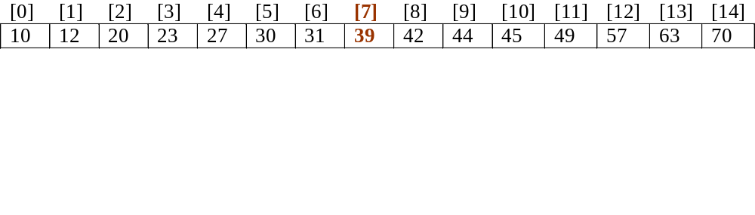
Example: Search for 44 in the previous array
item = 44 list.length = 15
first = 0 last = list.length – 1
midPoint = (first + last)/2 = (0 + 14)/2 = 7
list.info
BSc in Software Development
Data Structures & Algorithms

Slide 11
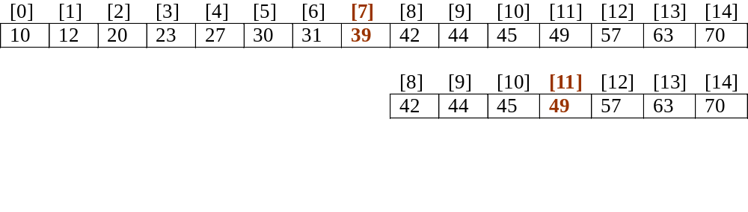
Example: Search for 44 in the previous array
item = 44 list.length = 15
first = 0 last = length – 1
midPoint = (first + last)/2 = (0 + 14)/2 = 7
list.info
midPoint = (8 + 14)/2 = 11
BSc in Software Development
Data Structures & Algorithms

Slide 12
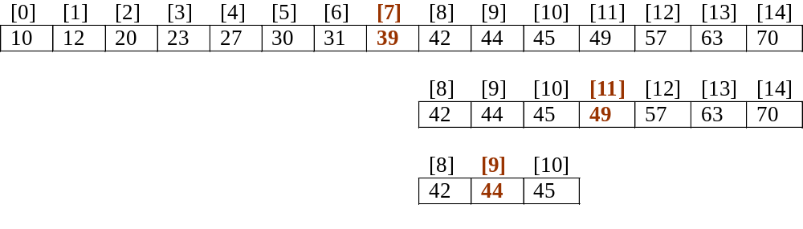
Example: Search for 44 in the previous array
item = 44 length = 15
first = 0 last = length – 1
midPoint = (first + last)/2 = (0 + 14)/2 = 7
info
midPoint = (8 + 14)/2 = 11
midPoint = (8 + 10)/2 = 9
BSc in Software Development
Data Structures & Algorithms

Slide 13
Example: Search for 44 in the previous array
item = 44 list.length = 15
first = 0 last = length – 1
midPoint = (first + last)/2 = (0 + 14)/2 = 7
list.info
midPoint = (8 + 14)/2 = 11
midPoint = (8 + 10)/2 = 9
item this time is equal to the element at the midpoint of the current search area, therefore set found = true
BSc in Software Development
Data Structures & Algorithms

Slide 14
Note:
If a comparison shows that the item comes before the element at the midpoint, the new current search area goes from index first to index midPoint – 1. Therefore update last = midPoint – 1.
If the comparison shows that the item comes after the element at the midpoint, the new current search area goes from index midPoint + 1 to index last. Therefore update first = midPoint + 1.
BSc in Software Development
Data Structures & Algorithms

Slide 15
How do we know when to quit searching?
2 possible terminating conditions:
  item has been found in the array
    item is equal to the element at the midpoint of the current search area
    item == list.info[midPoint].
  item is not in the array
    there is no more to search in the current search area, i.e. it is empty
    first > last
Two terminating conditions on the loop
  moreToSearch and not found
BSc in Software Development
Data Structures & Algorithms

Slide 16
Putting it all together:
void BinarySearch (ListType list, int & item, bool & found)
{
int midPoint;
int first = 0;
int last = list.length – 1;
bool moreToSearch = first <= last;
found = false;
BSc in Software Development
Data Structures & Algorithms

Slide 17
while (moreToSearch && !found)
{
midPoint = (first + last)/2
if (item < list.info[midPoint])
{
last = midPoint – 1;
moreToSearch = first <= last;
}
else if (item > list.info[midPoint])
{
first = midPoint + 1;
moreToSearch = first <= last;
}
BSc in Software Development
Data Structures & Algorithms

Slide 18
else
{
item = list.info[midPoint];
found = true;
}
}
}
BSc in Software Development
Data Structures & Algorithms

Slide 19
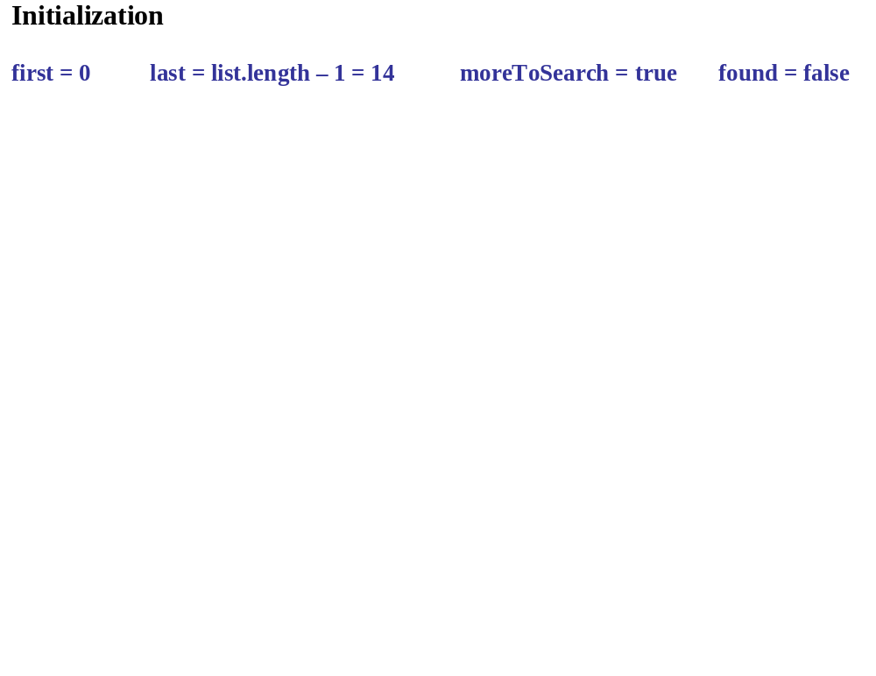
BSc in Software Development
Data Structures & Algorithms

Slide 20
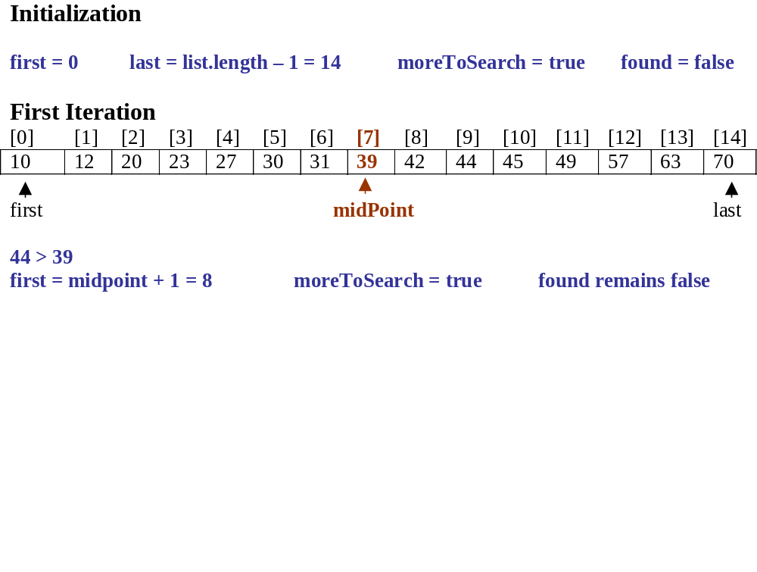
BSc in Software Development
Data Structures & Algorithms

Slide 21
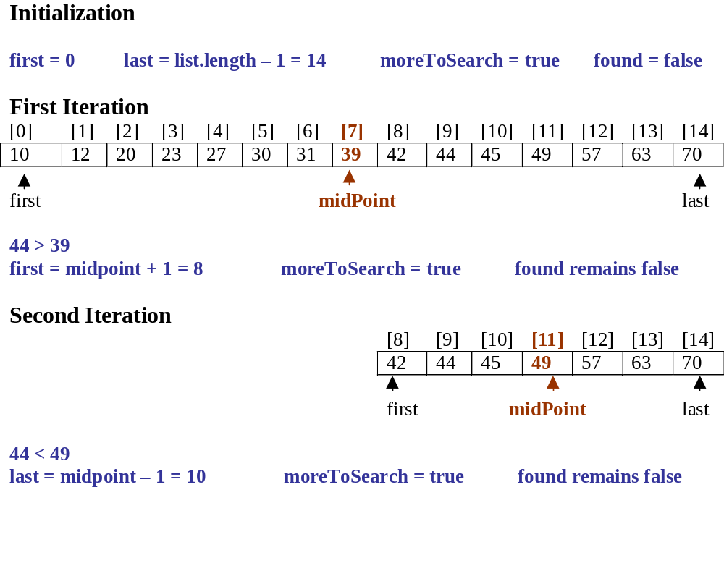
BSc in Software Development
Data Structures & Algorithms

Slide 22
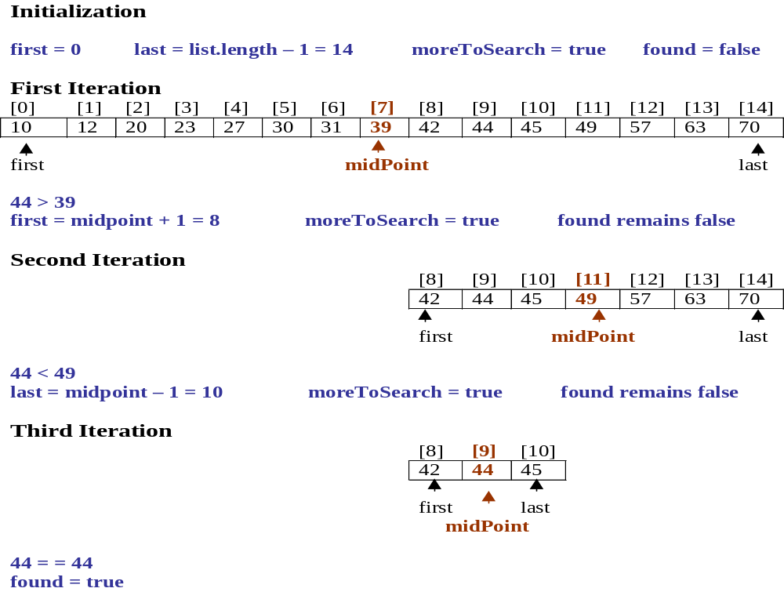
BSc in Software Development
Data Structures & Algorithms

Slide 23
Binary Search v Linear Search
Using a Binary Search, 20 steps or comparisons will locate the item in an array containing more than 1,000,000 elements:
  2²⁰ = 1,048,576
  So the number of times 1,048,576 can be halved is 20
  Therefore at worst the Binary Search is going to halve 20 times before finding the item or determining that it is not present.
Linear Search would make on average 524,288 comparisons, 1 at best and 1,048,576 comparisons at worst.
But more work is done each time around the Binary Search loop, so it is only more efficient than a linear search when the number of elements to be searched is more than 20.
BSc in Software Development
Data Structures & Algorithms

Slide 24
Note:
In order to improve on the efficiency of a Binary Search reduce the number of conditions that need to be checked.
Are two conditions on the while loop necessary?
Do we need to check for item < list.info[middle] and then check for item > list.info[middle] with the else clause item == list.info[middle].
Two other versions:
The Forgetful version
Recognising Equality Version
BSc in Software Development
Data Structures & Algorithms

Slide 25
The Forgetful version:
Forget the possibility that item might be found quickly and continue whether item has been found or not to subdivide the list until what remains has length 1.
int ForgetfulBinarySearch (ListType list,
int item, bool & found)
/* Post: If found the function returns to position of item in list.info. Otherwise it returns –1. */
{
int first = 0;
int last = list.length – 1;
int midPoint;
found = false;
BSc in Software Development
Data Structures & Algorithms

Slide 26
while (first < last)
{
midPoint = (first + last) / 2;
if ( item > list.info[midPoint])
first = midPoint + 1;
else
last = midPoint;
}
BSc in Software Development
Data Structures & Algorithms

Slide 27
if (last == -1)
return –1;
else if (item == list.info[first])
{
found = true;
return first;
}
else
return –1;
}
BSc in Software Development
Data Structures & Algorithms

Slide 28
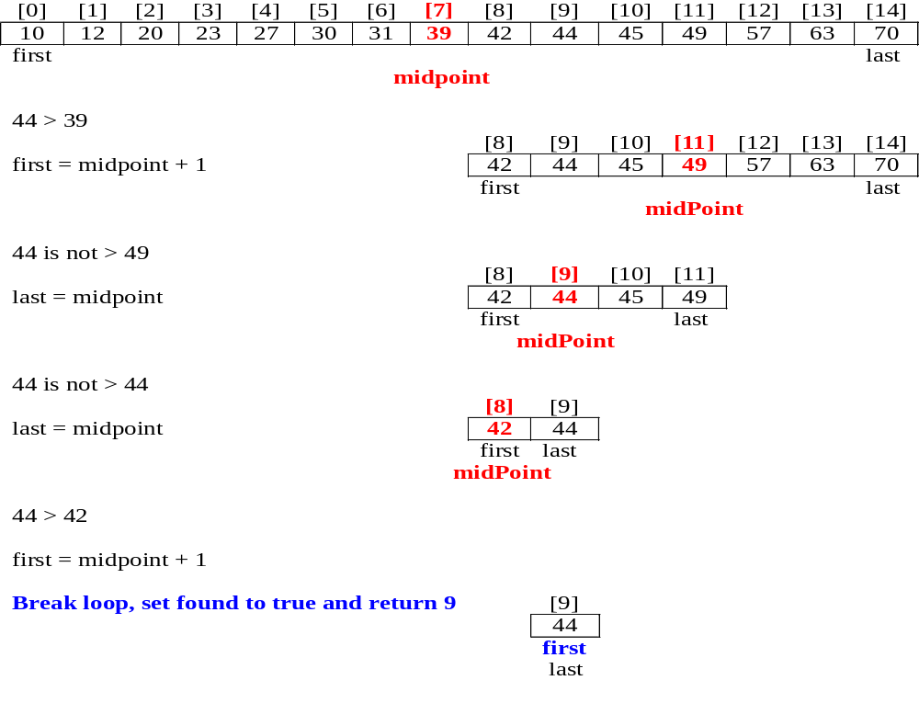
Example: Successful Search item = 44
BSc in Software Development
Data Structures & Algorithms

Slide 29
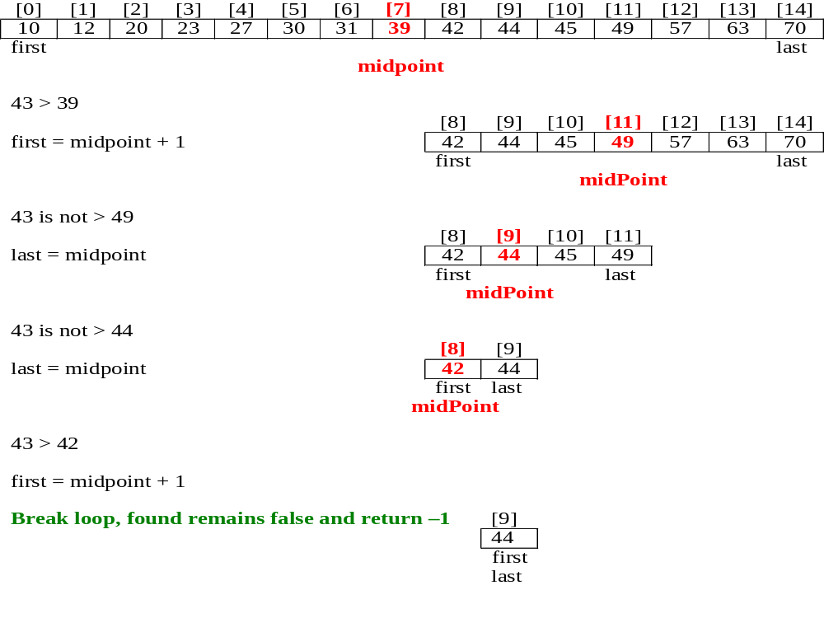
Example: Unsuccessful Search item = 43
BSc in Software Development
Data Structures & Algorithms

Slide 30
Recognising Equality:
The forgetful version of the binary search will often make unnecessary iterations because it fails to recognise that it has found the item before continuing to iterate.
Execution time may be saved with a variation that checks at each stage to see if it has found the item.
Again here the position of item in list.info is returned it found.
This is really another variation of our original version.
BSc in Software Development
Data Structures & Algorithms

Slide 31
int REBinarySearch (ListType list, int item, bool & found)
/* Post: If found the function returns to position of item in list.info. Otherwise it returns –1. */
{
int first = 0;
int last = list.length – 1;
int midPoint;
found = false;
BSc in Software Development
Data Structures & Algorithms

Slide 32
while (first <= last)
{
midPoint = (first + last) / 2;
    if ( item == list.info[midpoint])
    {
    found = true;
    return midpoint;
    }
    else if (item > list.info[midPoint])
first = midPoint + 1;
else
last = midPoint - 1;
}
return –1;
}
BSc in Software Development
Data Structures & Algorithms

Slide 33
Comparison of Methods:
Which version will do fewer comparisons?
REBinarySearch() will if item is near the beginning of the search.
But each iteration requires 2 comparisons whereas ForgetfulBinarySearch() requires only 1.
It is possible that if many iterations are needed, then ForgetfulBinarySearch() may do fewer comparisons than REBinarySearch().
BSc in Software Development
Data Structures & Algorithms

